Slide 1

Depreciation Calculator
by Aashish Kaaley

Slide 2
Comparative Analysis of Depreciation Methods
Straight-Line vs. Diminishing Balance
We will explore how Straight-Line and Diminishing Balance methods impact asset valuation and financial statements, particularly in automated financial models like those built in Excel.

Slide 3

Introduction & Scope
What is Depreciation?
Why it Matters
Project Objective
Systematic Allocation: It's the process of allocating the cost of a tangible asset over its useful life, reflecting its gradual reduction in value due to wear and tear, obsolescence, or usage.
Financial Impact: Depreciation helps match an asset's cost to the revenue it helps generate. It significantly influences a company's balance sheet, income statement, and ultimately, its tax liabilities and deductions.
Method Comparison: Our goal is to compare the financial implications of the Straight-Line (SL) and Diminishing Balance (DB) depreciation methods, guiding businesses in selecting the most appropriate approach for their assets and financial strategy.

Slide 4

Baseline Data Model: Key Inputs
To accurately compare depreciation methods, we establish a consistent set of initial assumptions for our asset.
$450K
$50K
$500K
$50K
Asset Cost
Additional Costs
Total Asset Price
Scrap Value
Initial purchase price.
Transportation and installation.
The full depreciable amount.
Expected value at end of life.
10
Life Span
Years of estimated useful life.

Slide 5
Method 1: Straight-Line (SL)
The Concept
The Formula
Provides a consistent, uniform annual depreciation expense over the asset's useful life.
(Asset Price - Scrap Value) / Estimated Life Span
Our Model Output
Pros & Cons
Total Depreciation: $450,000
Annual Expense: $45,000 every year
Depreciation Percentage: 9%
Simple to calculate, but may not reflect the actual loss of value for assets with rapid obsolescence.

Slide 6
Method 2: Diminishing Balance (DB)
Dynamic Allocation
The Calculation
Assigns a larger depreciation expense in the asset's early years, gradually decreasing over its useful life.
(Book Value at Beginning of Year) * (Depreciation Rate)
This method requires calculating the remaining book value each period, leading to a varying expense.
Key Results
Strategic Implications
Depreciation Rate: 20.57%
Year 1 Expense: $102,836
Year 2 Expense: $81,685
Better reflects accelerated loss of value for assets, but involves more complex, iterative calculations compared to straight-line.

Slide 7
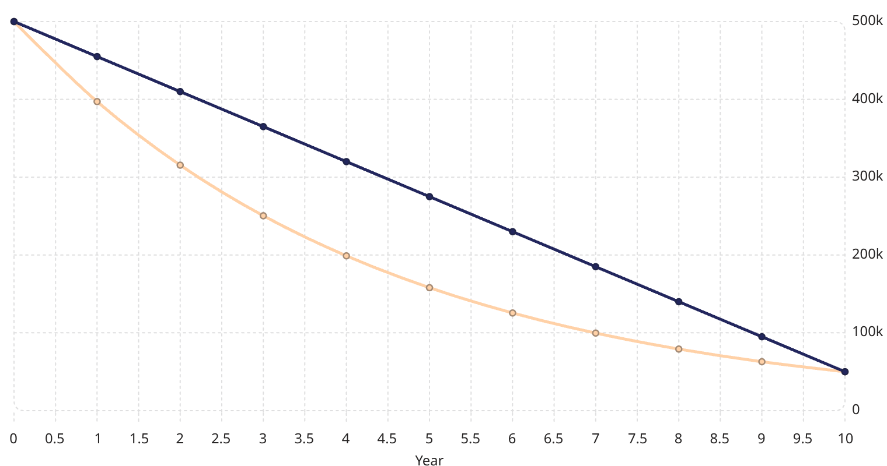
Comparative Visual Analysis
Diminishing Balance (DB)
Straight-Line (SL)
500k
500k
455k
397k
410k
365k
315k
320k
275k
250k
230k
199k
185k
158k
140k
126k
99.7k
79.2k
95k
62.9k
50k
50k
This line chart illustrates how the book value of our asset declines over its 10-year lifespan under both the Straight-Line (SL) and Diminishing Balance (DB) depreciation methods.
The SL Trajectory shows a consistent, linear reduction in value of $45,000 each year, reaching the $50,000 scrap value precisely at year 10.
The DB Trajectory exhibits an exponential curve, with over $180,000 of value depreciated in the first two years. This aggressive early depreciation gradually flattens out, mirroring the faster decay of value often seen in new assets.
Notice around year 7, where the diminishing balance curve falls below the straight-line, highlighting how the DB method allocates more depreciation earlier in the asset's life.

Slide 8
Key Findings
1
Total Cost Equality
2
Timing of Expense
3
Year 4 Benchmark
Both methods resulted in the exact same total depreciation ($450,000) over 10 years, leaving a final book value equal to the scrap value ($50,000).
The Diminishing Balance (DB) method front-loads the financial expense, which can be highly beneficial for early tax deductions.
By Year 4, the DB method shows a significantly lower remaining book value than the Straight-Line (SL) method, perfectly modeling the reality of obsolescence.

Slide 9
Conclusions & Recommendations
When to use Straight-Line
When to use Diminishing Balance
Strategic Choice
Ideal for assets providing consistent utility over time, like office furniture or commercial buildings, ensuring a predictable annual depreciation expense.
Both methods offer distinct merits. The optimal choice depends on the asset's nature and your business's financial objectives and tax strategy.
Best for high-performance assets that rapidly lose value or become obsolete quickly, such as IT infrastructure, laptops, and fleet vehicles.

Slide 10
Thank You !

